Slide 1

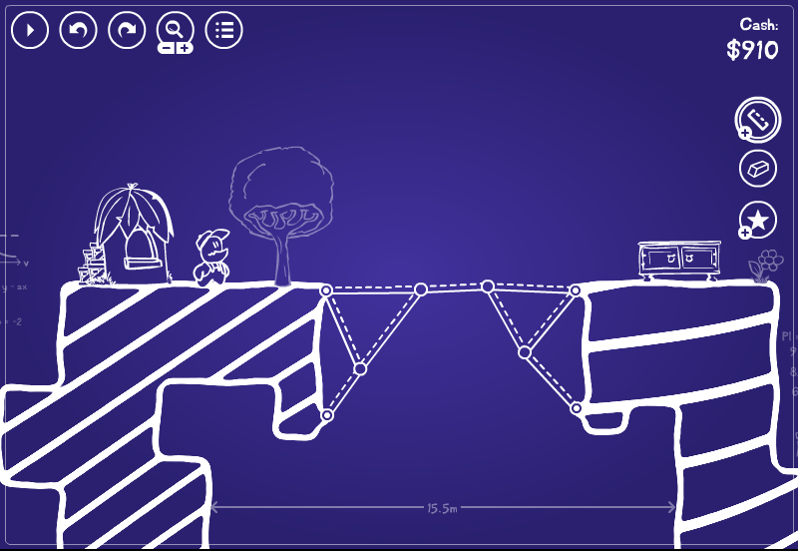
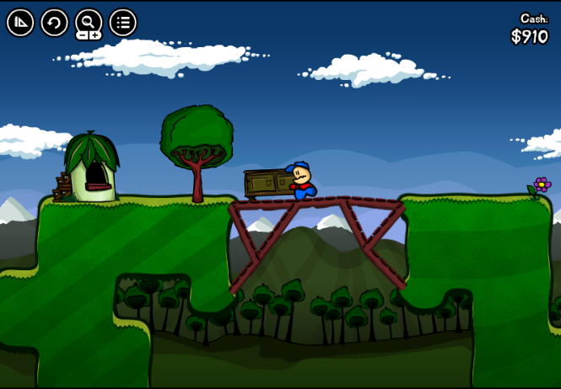
A computer game to study design fixation
Maria A. Neroni, Luis A. Vasconcelos, Nathan Crilly
DCC’16 Workshop: Games for Design Research and Education

Slide 2
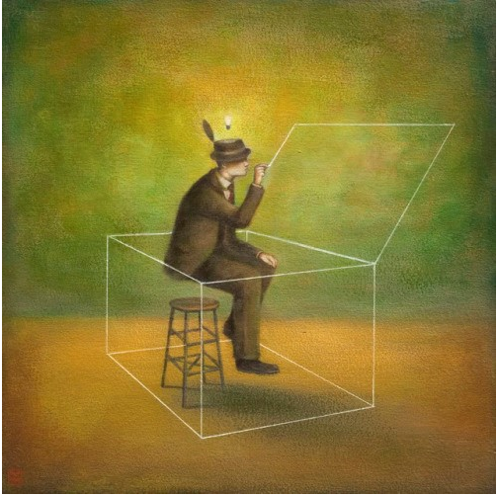
Design Fixation
The term ‘Design Fixation’ is often used to refer to situations in which designers limit their creative output due to an overreliance on features of pre-existing designs, or more generally, an overreliance on a specific body of knowledge directly associated with a problem

Slide 3
How fixation effects have been studied
Psychology studies
Problem solving tasks requiring the identification of a novel or unusual solution
Simple problems (e.g. measuring out precise volumes of water; tying two distant strings together; fixing a candle to the side of a wall with limited tools)
Well-defined problems (i.e. problems with a pre-determined, limited number of solutions)
Design studies
Typical design tasks requiring the generation of many novel and diverse solutions
Complex problems (e.g. designing a car-mounted bicycle rack; developing a concept for an automated rent-a-car facility; designing a device to retrieve a book from a shelf that is out of reach)
Ill-defined problems (i.e. problems admitting an undefined or unlimited number of solutions)
Notes:
The notion of fixation originated primarily in Gestalt theory, where a series of studies were conducted to explore the occurrence of this behaviour. In psychology, it was studied with… To get experimental control, these problems are usually very simple… and well defined. The concept of ‘design fixation’ was developed from these psychology studies, with the term initially being used to refer to ‘a blind adherence to a set of ideas or concepts limiting the output of conceptual design’. It was then studied with…

Slide 4
From a quantitative to a qualitative approach…
The complex and ill-defined nature of the design problems imply that performance in these tasks cannot be exclusively measured in terms of the quantity of solutions generated, but has to also be evaluated in terms of the quality of the solutions
As a result...
The use of subjective metrics to evaluate the design outcome has become very common in design literature (e.g. novelty, practicality, feasibility, etc.)
Problems with this approach:
Very subjective
Great diversity of the procedures
Results that are often non-comparable
Great variety in the outputs that participants can provide while working on the design tasks
Our proposal:
Studying design fixation with computer games inspired by experimental paradigms used in psychology research
Notes:
These particular features of the design problems imply that…

Slide 5
Using a computer game to study the Einstellung Effect
The Einstellung Effect, or Mental Set, is the development of a mechanized state of mind. It occurs when the first idea that comes to mind, triggered by previous experience with similar situations, prevents alternatives being considered. If this initial idea is not the best way to solve the problem, the optimum solution may be missed
Water-jar problem (Luchins, 1942)
How would you use three jars with the indicated capacities to measure out the desired amount of water?
Problem | Jar A | Jar B | Jar C | Desired quantity of water | Solution
1 | 21 | 127 | 3 | 100 | B - A - 2C
2 | 14 | 163 | 25 | 99
3 | 18 | 43 | 10 | 5
4 | 9 | 42 | 6 | 21
5 | 20 | 59 | 4 | 31
6 | 23 | 49 | 3 | 20 | B - A - 2C or A ± C
7 | 15 | 39 | 3 | 18
8 | 28 | 76 | 3 | 25 | A - C
9 | 18 | 48 | 4 | 22 | B - A - 2C or A ± C
10 | 14 | 36 | 8 | 6
Einstellung trials
Critical trials
Extinction trial
Critical trials
Notes:
In exploring the potential for games like this to offer a platform for studying design fixation, we were inspired by one of the experimental paradigms most commonly used to investigate fixation effects in the psychological literature: the water-jar task developed by Luchins to study the Einstellung Effect.

Slide 6
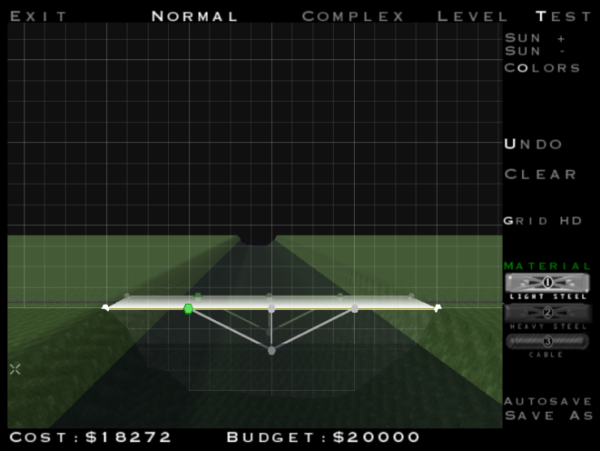
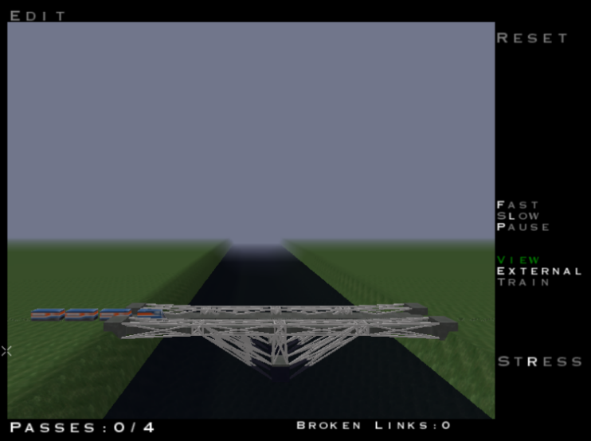
… From a qualitative to a quantitative approach
Our computer-based task will consist of a simple game-like design activity. The overall purpose of the game is to design a bridge across a river that can support the specified load without exceeding the specified budget
Design Mode
Test Mode
Screens from the game Pontifex, developed by Chronic Logic
Notes:
Following the original Luchins’ paradigm, we are developing a computer game task. Right now, the game is an adopted version of the existing game Pontifex, developed by Chronic Logic. It consists of…

Slide 7
Show them the Pontifex game, why not?
Notes:
NC: yes- if you have time.

Slide 8
Game details
RULES
To design bridges that are strong enough to support their own weight and other loads that are placed upon them;
To pass each trial, the bridge must withstand the load of a train passing across it without suffering any broken links; If that happens, the bridge must be redesigned and retested;
There is (currently) no limit for the number of attempts (i.e. testing the bridge);
There is (currently) no time limit for each trial
MECHANICS There is a design mode to design the bridge and a test mode to test it;
Bridges are made out of segments that are linked to each other with anchor points;
Not all anchor points can or should be used in order to construct the bridges;
Bridge links break when the structure is not strong enough to support either its own weight or other loads;
For each trial, there is a limited budget;
Each piece of the bridge costs money
GOAL
To construct the cheapest bridge possible!

Slide 9
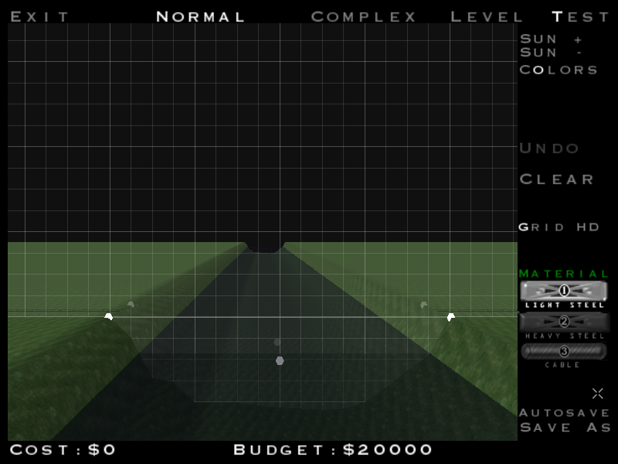

Einstellung trials
Problem
Solution
Solution: Using all the anchor points

Slide 10
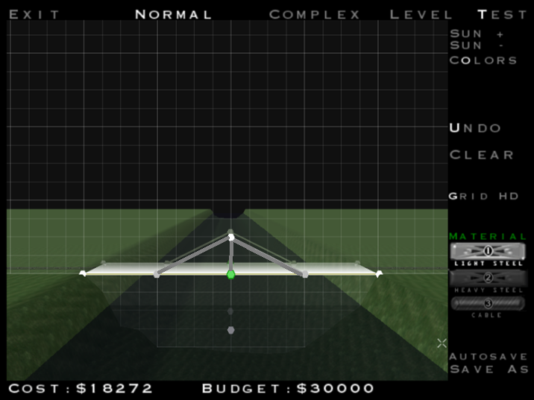
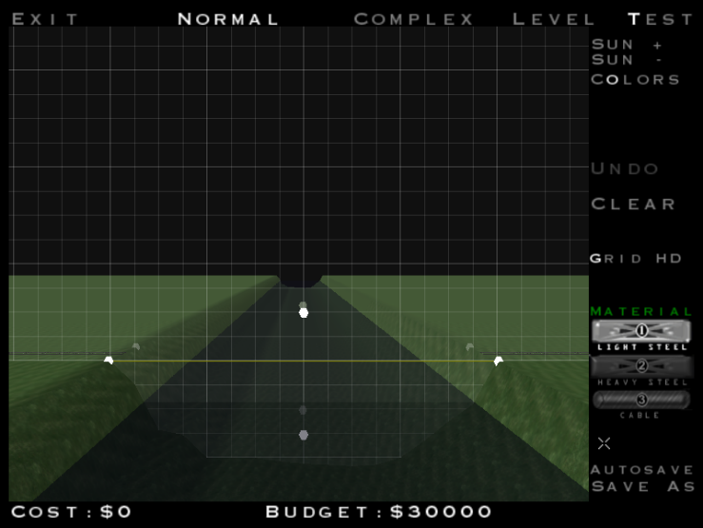
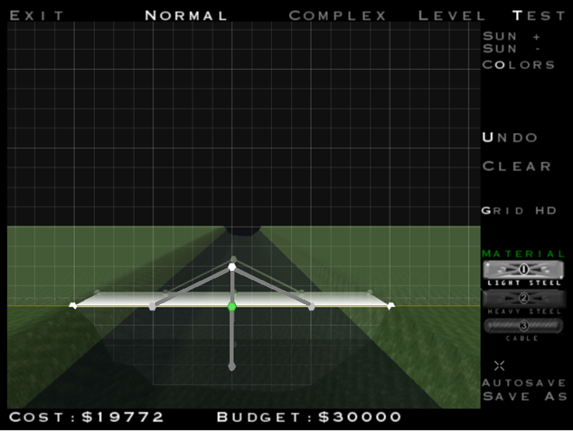
Critical trials
Cheaper
Solution: Using not all the anchor points
Problem
More expensive
Solution: Using all the anchor points

Slide 11
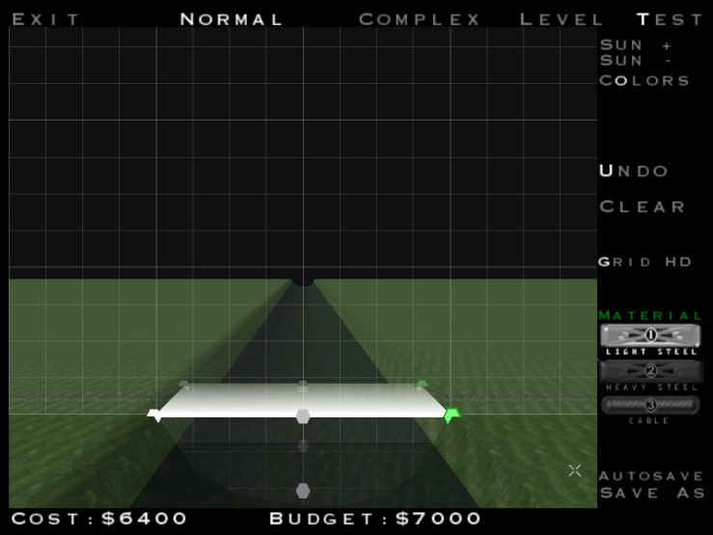
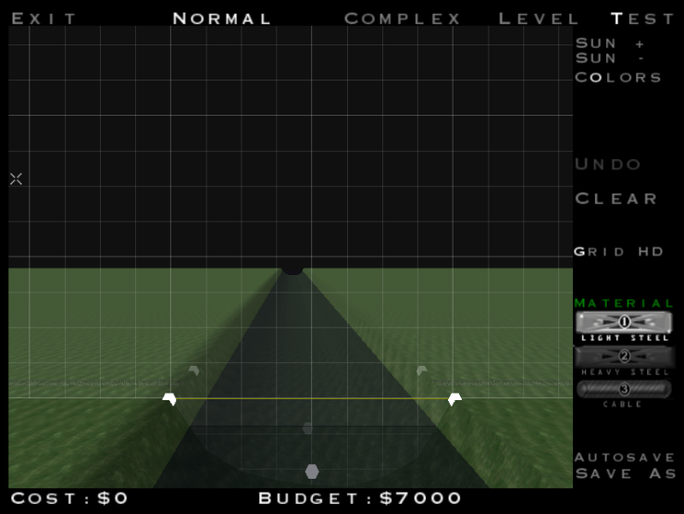
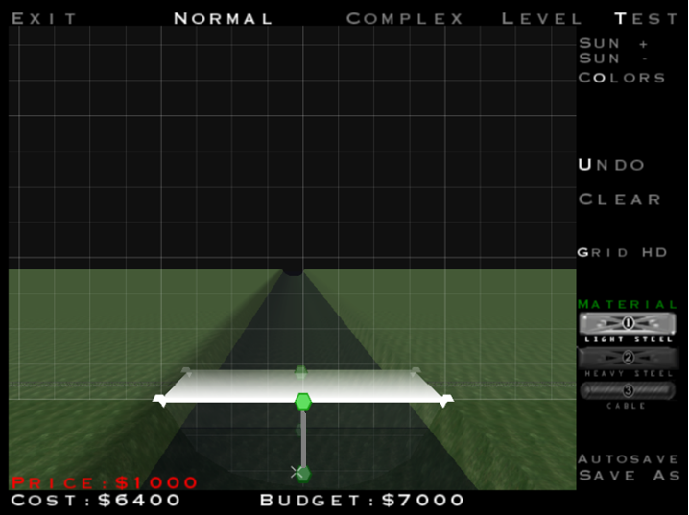
Extinction trials
Possible
Solution: Using not all the anchor points
Problem
Not possible Solution: Using all the anchor points

Slide 12
Possible variations for future studies
Varying or limiting the number of trials
Giving a time constraint to complete each trial
Including an incubation period after the Einstellung trials
Evaluating the efficacy of particular strategies, such as writing “Don’t be blind” on the performance
Comparing the performance of novices vs. expert designers
Comparing the performance of designers with different academic backgrounds
Evaluating the effect of age on performance
Etc.

Slide 13
Using our computer game for fixation experiments
Advantages
Disadvantages
Increased engagement and immersion, thus lower chances of hypothesis awareness and other participants’ bias
Strong compatibility with other data capture tools such as audio (e.g. verbal protocols) and video (e.g. eye-tracking)
More controlled data capture and a more objective analysis of design behavior
Reduced variability in the type of outputs that participants can provide
More comparable results within and between studies
More direct assessment of the effects of particular constraints (e.g., time, budget)
The number of possible solutions is still limited if compared to other creative design tasks
Many confounding variables can influence performance (i.e. experience with computer games or with the design activity)
Limited possibilities to extend the results to other design domains
Research taken less seriously by the scientific community?
Notes:
First of all, It is very difficult to arrive at tasks that are properly controlled and yet flexible enough to permit creative design work to be performed. But there are clear advantages for the game approach to fixation…

Slide 14
Benefits of creating our own game
Increased customisation of levels
Chance to adopt a more cartoon-like appearance
Chance to create more riveting and unrealistic scenarios
Increased control over our ‘fixation metrics’, such as resources, time, number of moves, and number of attempts

Slide 15
Thank you for your attention!
Maria Adriana Neroni: man52@cam.ac.uk
(Presenter) Luis Arthur Vasconcelos: lal40@cam.ac.uk
Nathan Crilly: nc266@cam.ac.uk

Slide 16
Experimental conditions
Fixation Condition
Control Condition
Einstellung trial
Einstellung trial
Einstellung trial
Einstellung trial
Einstellung trial
Critical trial
Critical trial
Extinction trial
Critical trial
Critical trial
Extinction trial
Einstellung trial
Critical trial
Einstellung trial
Extinction trial
Critical trial
Critical trial
Einstellung trial
Extinction trial
Critical trial

Slide 17
How fixation effects have been studied
Psychology studies
Problem solving tasks requiring the identification of a novel or unusual solution
Simple problems (e.g. measuring out precise volumes of water; tying two distant strings together; fixing a candle to the side of a wall with limited tools)
Well-defined problems (i.e. problems with a pre-determined, limited number of solutions)
Design studies
Typical design tasks requiring the generation of many novel and diverse solutions
Complex problems (e.g. designing a car-mounted bicycle rack; developing a concept for an automated rent-a-car facility; designing a device to retrieve a book from a shelf that is out of reach)
Ill-defined problems (i.e. problems admitting an undefined or unlimited number of solutions)
Notes:
measuring out precise volumes of water, Luchins, 1942 tying two distant strings together, Maier, 1931
fixing a candle to the side of a wall with limited tools, Duncker 1945
designing a car-mounted bicycle rack, Jansson & Smith, 1991
developing a concept for an automated rent-a-car facility, Ball et al., 2004
designing a device to retrieve a book from a shelf that is out of reach, Cardoso & Badke-Schaub, 2011

Slide 18
Important differences between our computer game and Luchins’ original paradigm
Water-jar problems
Our computer game
Mathematical problems
Well-defined problems (i.e., problems with a pre-determined, limited number of solutions)
Simple design task
Ill-defined problems (i.e., problems admitting an undefined or unlimited number of solutions)
These extra experimental manipulations will avoid compromising the creative nature of the task thus maintaining some alignment with the relevant design literature

Slide 19
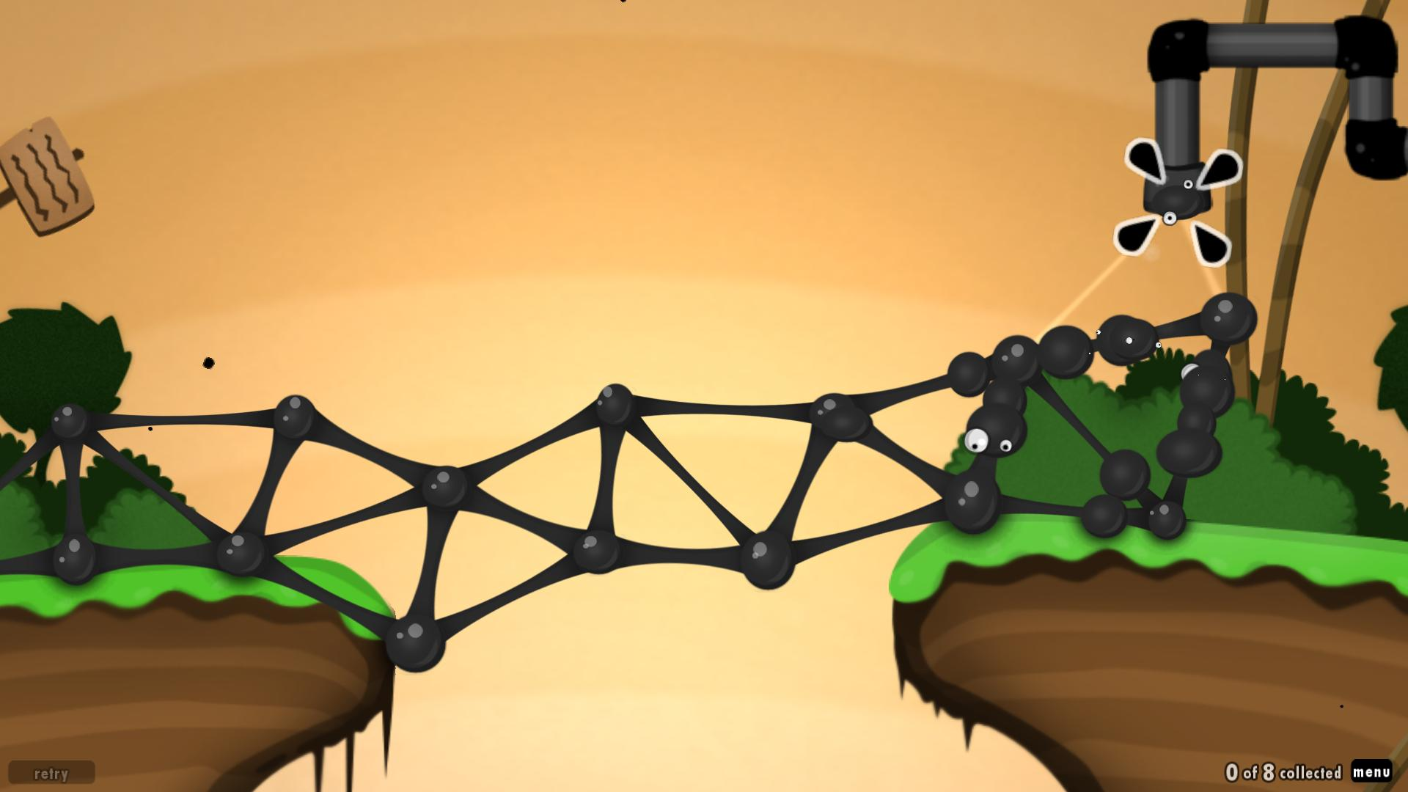
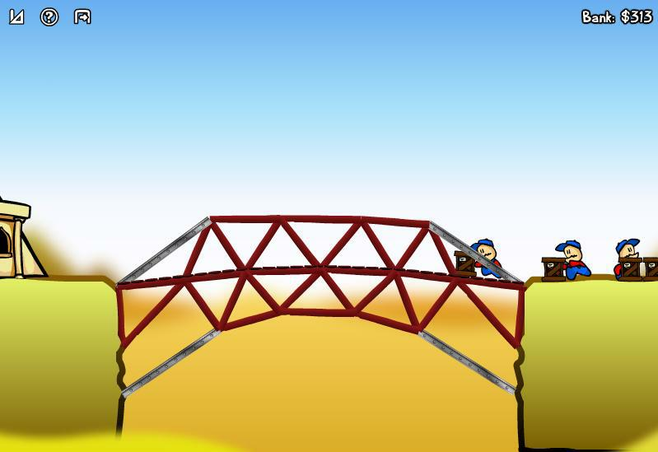
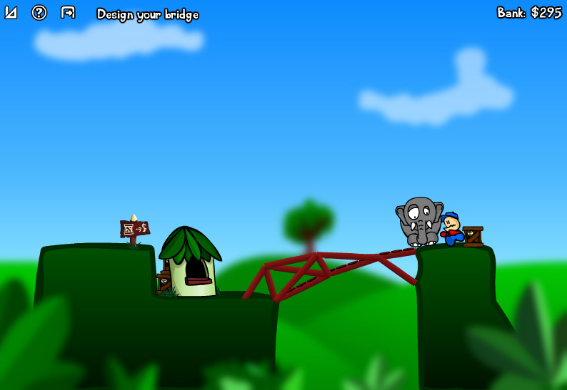
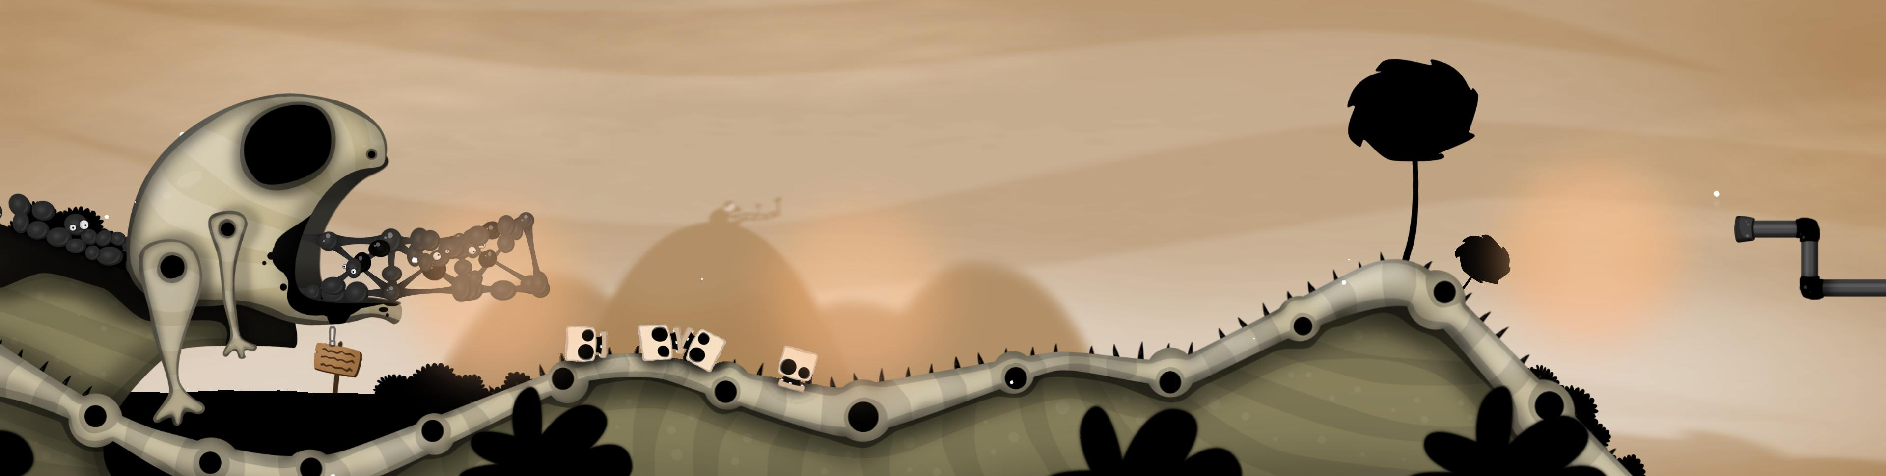
Notes:
Examples of cartoon-like aesthetics

Slide 20
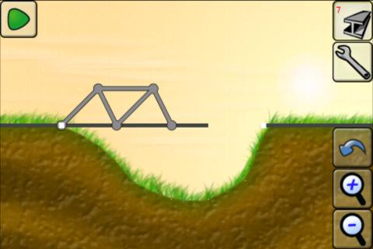
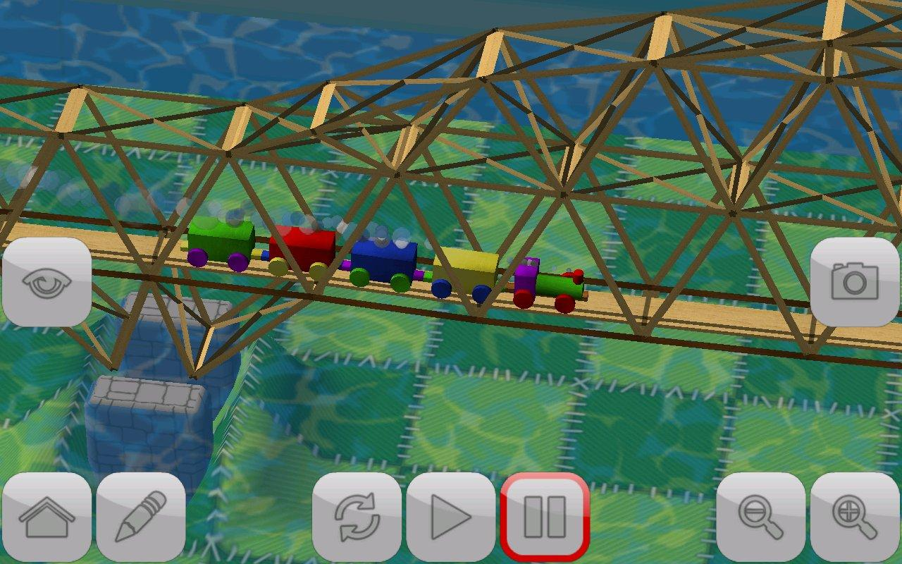
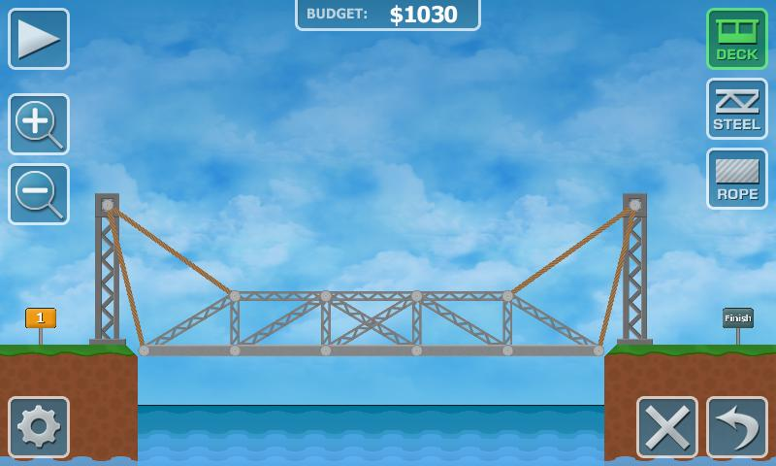
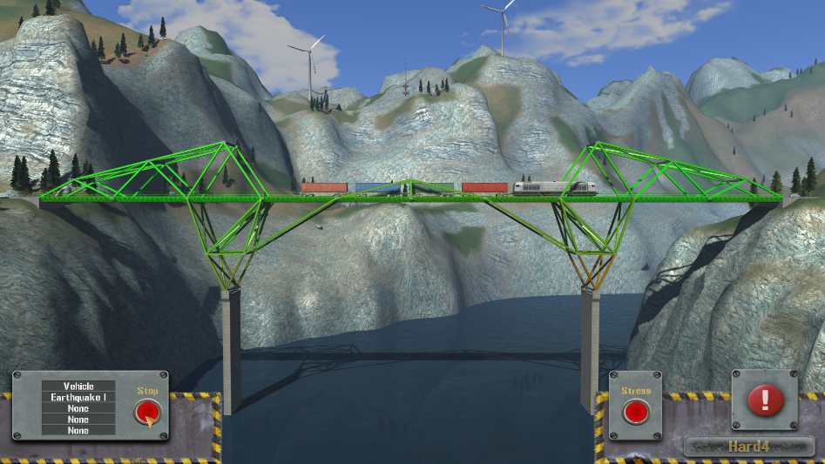
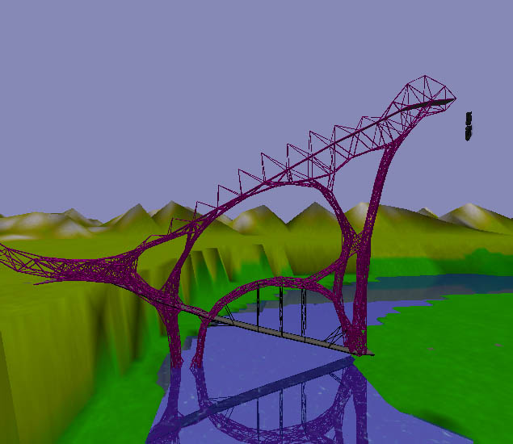
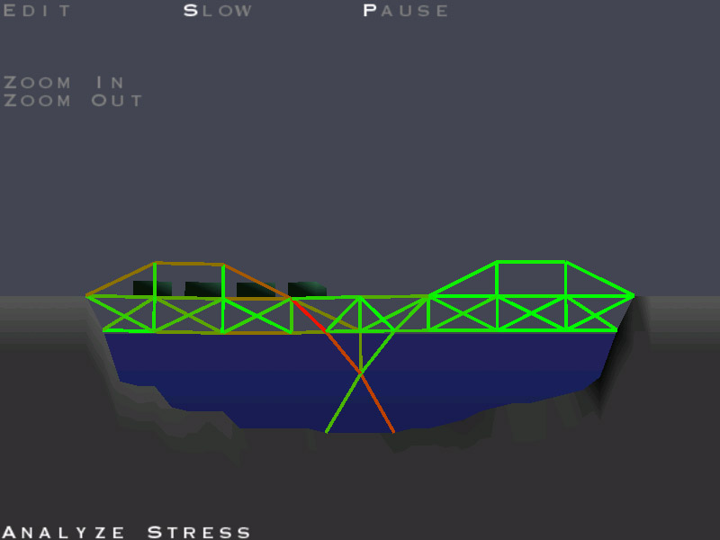
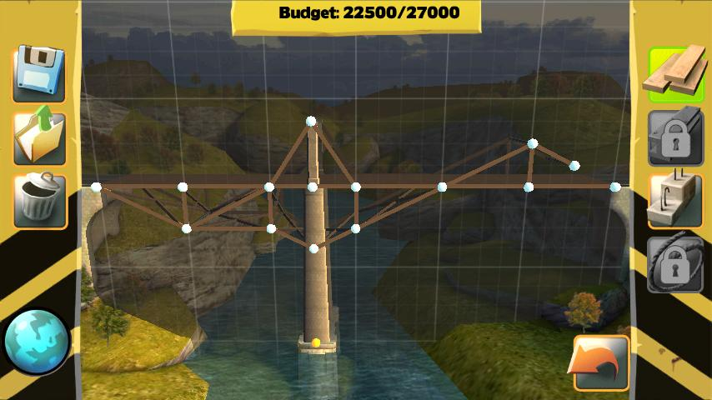
Notes:
Examples of similar bridge games

